Slide 1


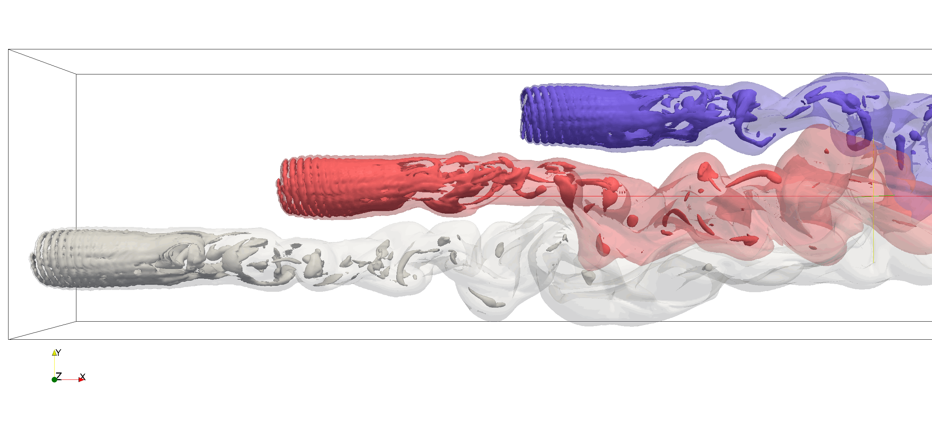
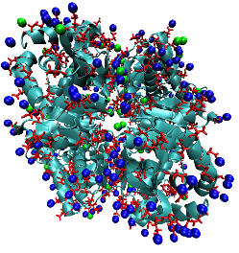
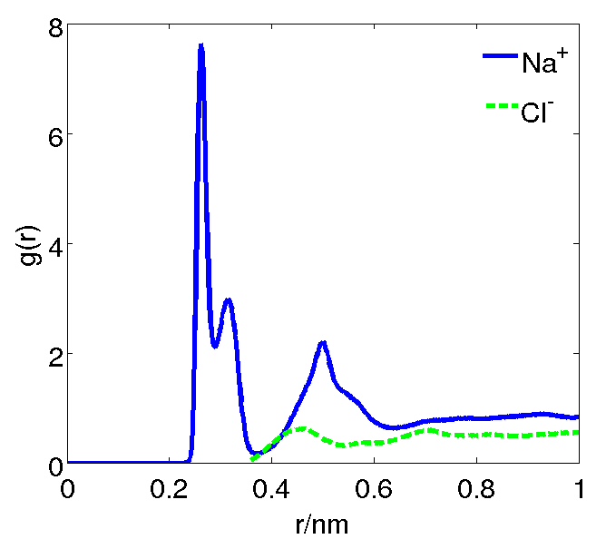
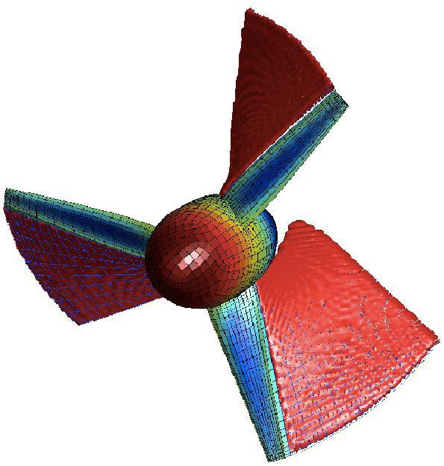
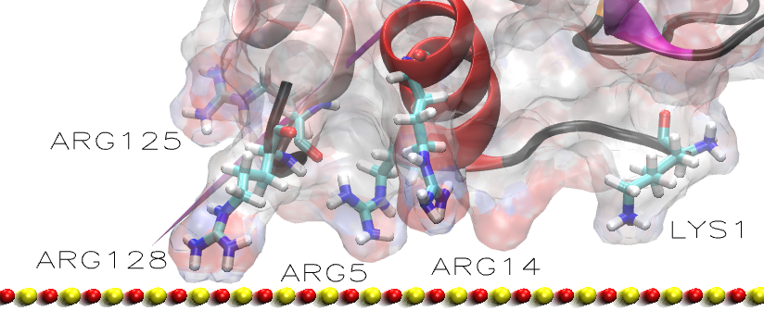
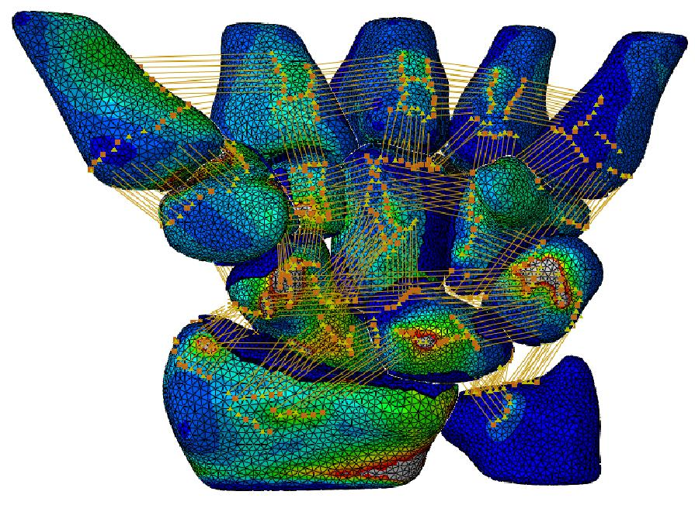
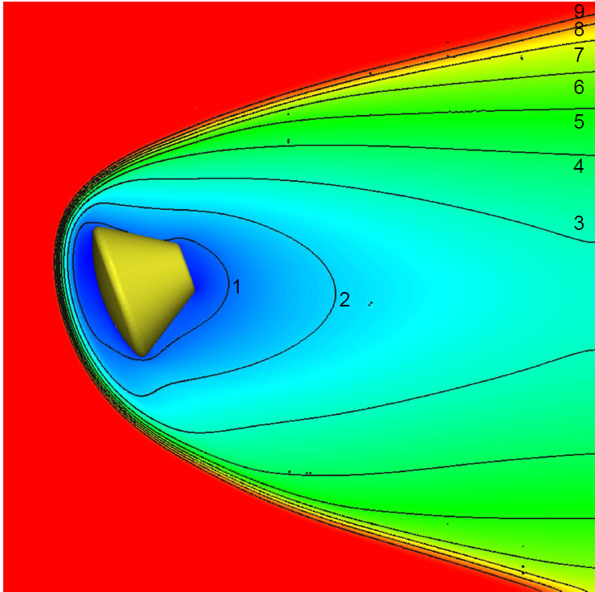
ARCHIE-WeSt
www.archie-west.sc.uk
Academic and Research Computer Hosting Industry and Enterprise in the West of Scotland
We are a supercomputer centre for the West of Scotland based at the University of Strathclyde and dedicated to wealth creation and research excellence. Funded by a seed e-infrastructure grant from EPSRC, we operate in partnership with the Universities of Glasgow, Glasgow Caledonian, West of Scotland and Stirling.
2M NaCl
The flow around turbines
Na+ and Cl- ions binding to hallophilic protein
Optimal-shaped
wind turbine
Protein adsorption on solid surface
Human wrist bone model
Water nanoflow through carbon nanotube
The flow around Orion – crew rescue vehicle
The aim of the centre is to support multi-disciplinary research, with a centre of gravity in engineering and physical sciences, while reaching out to other disciplines and to encourage and enable industrial usage and collaboration.
Technical Specification of ARCHIE-WeSt
ARCHIE-WeSt is a state-of-the-art water cooled 38 Teraflop HPC Facility located at the University of Strathclyde
Standard Nodes: | 3408 2.66GHz Intel Xeon X5650 cores (Westmere), 48GB RAM (4GB per core)
Large Memory Nodes: | Eight 512GB RAM nodes, 2 Intel Xeon E7-4830 2.13GHz CPU’s
GPU Nodes: | Eight Standard Nodes each with Nvidia Tesla M2075 GPU cards (448 cores, 6GB RAM)
Visualisation Nodes: | Two Dell R5500 servers with Nvidia Quadro 6000 graphics. 2 Xeon X5650 CPU’s, 48BG RAM
Network: | QDR Infiniband 40GB/s networking throughout the whole cluster
Storage: | 150TB of high performance LUSTRE parallel storage, capable of 3.5GB/s data transfer
Competitive charges for using ARCHIE-WeSt
ARCHIE-WeSt is a non-profit making facility focused on supporting Research and Enterprise in the West of Scotland.
Institution | Core-hour price + VAT
Consortia University | £0.04
Other University | £0.06
Industry | £0.10
Charges are calculated per Allocation Unit of CPU time, defined as 1 core-hour on ARCHIE-WeSt standard compute node i,e. one core-hour of Intel Xeon X5650 2.66GHz CPU.
Service Element | AU multiplier
Standard Node | 1.0
Large Memory Node | 1.5
GPU Node | 10.0
Different parts of the service will be charged at different multiplies of the Allocation Unit
Our package
We offer HPC access at highly competitive price, consultancy in HPC related areas, user-specific training courses, free introductory compute hours for feasibility studies, free introductory training and assistance, priority service for commercial customers, academic consultations, advanced trainings and many more.

