Slide 1





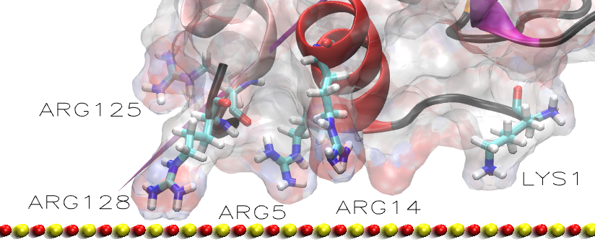
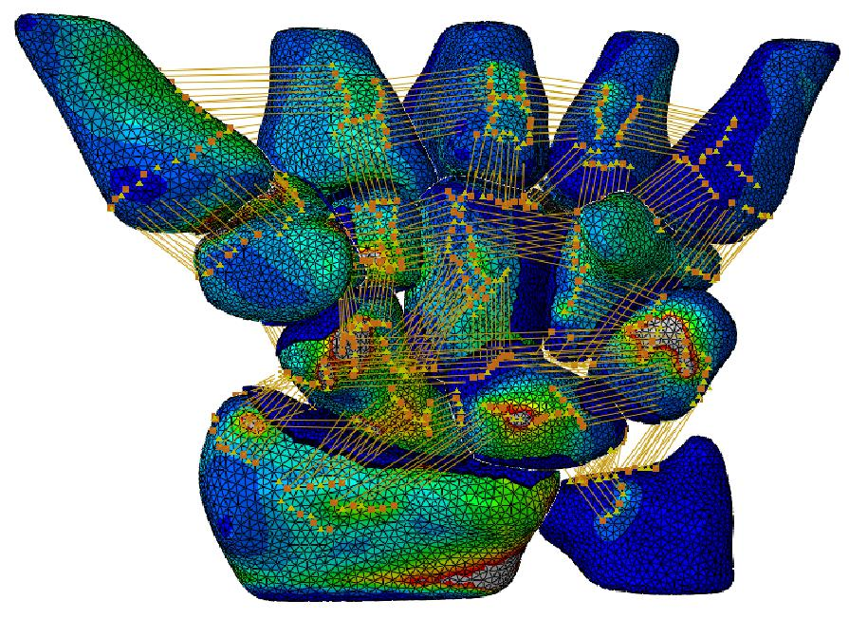




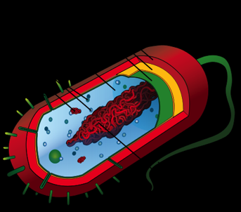
www.archie-west.ac.uk
Free HPC access until March 31st 2013
for universities in the West of Scotland
We are a supercomputer centre for the West of Scotland based at the University of Strathclyde and dedicated to wealth creation and research excellence. Funded by EPSRC, we operate in partnership with the Universities of Glasgow, Glasgow Caledonian, West of Scotland and Stirling.
We offer free HPC access, support & training
Apply now for access at www.archie-west.ac.uk
Current use of ARCHIE-WeSt includes:
Molecular modelling
Biological Science
Computational Fluid Dynamics
Analysis of large data sets
Nano-optics
Environment science
Sound and Video signaling
and many more ….
Imoprtant: The access is free of charge until 31st of March 2013. From 1st of April the Terms and Conditions apply.

