Slide 1

Academic and Research Computer Hosting Industry and Enterprise in the West of Scotland
www.archie-west.ac.uk

Slide 2

Who we are
We are a supercomputer centre for the West of Scotland based at the University of Strathclyde and dedicated to wealth creation and research excellence. Funded by EPSRC, we operate in partnership with the Universities of Glasgow, Glasgow Caledonian, West of Scotland and Stirling.
The aim of the centre is to support multi-disciplinary research, with a centre of gravity in engineering and physical sciences, while reaching out to other disciplines and to encourage and enable industrial usage and collaboration.

Slide 3
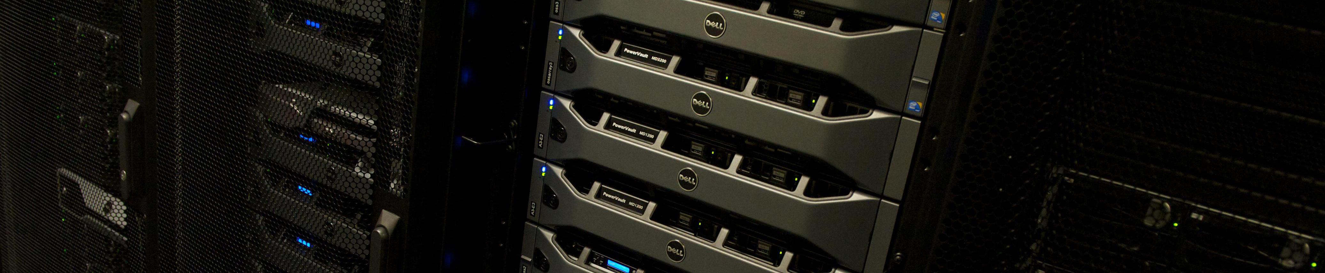
Who we are
The Academic and Research Computer Hosting Industry and Enterprise in the West of Scotland (ARCHIE-WeSt) was established in March 2012 by a £1.6M award from the EPSRC e-Infrastructure fund to establish a “Tier-2” regional centre of excellence in High Performance Computing (HPC).

Slide 4
Our strategic goals
Provide a step-change in HPC resource availability and accessibility to expand research collaboration in the West of Scotland
Catalyse new computational science and engineering research and knowledge exchange collaborations
Promote HPC capabilities to industry
Provide HPC training including the use of state-of-the-art software
Work in partnership with national/regional enterprise organisations and other supercomputing centres
Support and promote the highest standards of computational science and engineering research

Slide 5
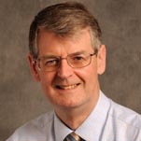
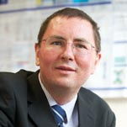
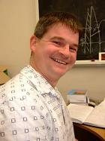
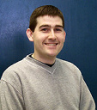
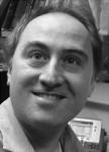
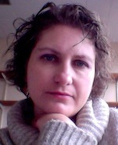
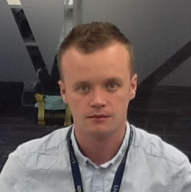
Our Team
Associate Deputy Principal (Prof. David Littlejohn)
Academic Director (Prof. Maxim Fedorov) and Operational Director (Dr Paul Mulheran)
Experienced HPC Manager (Dr Richard Martin) and Technical System Administrator (Mr Jonathan Buzzard)
Dedicated User Support Manager (Dr Karina Kubiak – Ossowska)
Business Development Manager (Dr Derek Bennet)
International Advisory Board includes Industrialists and Academics
We are committed to supporting Academia and Industry to exploit High Performance Computing, helping to deliver projects efficiently and effectively.

Slide 6
Our Service
HPC at a highly competitive price
Free introductory compute hours for feasibility studies
Free introductory training and assistance
Priority service for commercial customers
Academic consultations
Advanced training including: advanced HPC methods, Molecular Modelling (MD, MC, QM, QM/MM) and Chemo/Bio Informatics, Computational Fluid Dynamics, Finite Element Modelling, Visualisation, Audio/Video Signal Processing, Statistical Analysis and Data Mining, Optimization, Computational Physics, Computational Nanotechnology …. .
NOT FOR PROFIT => EXCELLENT VALUE FOR MONEY

Slide 7
HPC Experience
at Strathclyde
Faculty of Engineering and Institute of Complex Systems (ICS) purchased HPC early 2010 (£550K)
Metrics after 2 years
90 active HPC users
40 PhD students performing significant computation
44 papers from Engineering
£7M grant funding underpinned by HPC

Slide 8
Technical Specification
ARCHIE-WeSt is a state-of-the-art water cooled 38 Teraflop HPC Facility located at the University of Strathclyde
Standard Nodes: | 3408 2.66GHz Intel Xeon X5650 cores (Westmere) 48GB RAM (4GB per core)
Large Memory Nodes: | Eight 512GB RAM nodes 2 Intel Xeon E7-4830 2.13GHz CPU’s
GPU Nodes: | Eight Standard Nodes each with Nvidia Tesla M2075 GPU cards (448 cores, 6GB RAM)
Visualisation Nodes: | Two Dell R5500 servers with Nvidia Quadro 6000 graphics. 2 Xeon X5650 CPU’s, 48BG RAM
Network: | QDR Infiniband 40GB/s networking throughout the whole cluster
Storage: | 150TB of high performance LUSTRE parallel storage, capable of 3.5GB/s data transfer

Slide 9
Technical Specification
ARCHIE-WeSt uses the Linux operating system but also offers Windows virtual machine where is required
It is possible to access ARCHIE-WeSt directly from a desktop computer using Remote Desktop software
We promote the use of Open Source software and provide the access to many standard packages
We also provide access to Commercial Software either under the terms of the user’s own license or via short term license lease

Slide 10
Software Examples
Open Source Packages Include:
OpenFOAM (for computational fluid dynamics)
GROMACS, NAMD and VMD (for molecular dynamics)
Octave (alternative to MATLAB)
ATLAS and R (data analysis and statistical computing)
GCC (Fortran, C and other compilers)
CUDA (for GPU programming)
BLAS and LAPACK (linear algebra), FFTW (Fourier Transforms)
Others can be installed on request

Slide 11
Software Examples
Commercial Software:
Ansys (Finite element / Computational fluid dynamics)
Abaqus (Finite elements)
MATLAB (Programming environment)
Comsol (Multiphysics software)
Schrodinger (Computational drug design)
ADF (Density Functional Theory Modeling Suite)
Others can be installed on request (subject to licensing terms)

Slide 12
Charges
ARCHIE-WeSt is a non-profit making facility focused on supporting Research and Enterprise in the West of Scotland. Therefore our charges are highly competitive.
Charges are calculated per Allocation Unit of CPU time, defined as 1 core-hour on ARCHIE-WeSt standard compute node i,e. one core-hour of Intel Xeon X5650 2.66GHz CPU.
Institution | Core-hour price + VAT
Consortia University | £0.04
Other University | £0.06
Industry | £0.10

Slide 13
Charges
Different parts of the service will be charged at different multiplies of the Allocation Unit to reflect the differing resources available.
Service Element | AU multiplier
Standard Node | 1.0
Large Memory Node | 1.5
GPU Node | 10.0

Slide 14
Charges
Data storage is free up to 100GB. Thereafter there is a monthly charge of £25 per 0.5TB
Our price includes basic support and training
Advanced support and training at additional cost.
Our charges compared with other HPC providers:
Facility | Advertised price core-hour price | Performance Adjusted Price* Comparing relative CPU performance
ARCHIE-WeSt | £0.04 - £0.10 | £0.04 - £0.10
HECToR | £0.10 | £0.13
Amazon | $0.16 | $0.40
*Prices determined by scaling peak CPU performance data according to figures published at www.spec.org . Prices exclude VAT

Slide 15
Summarizing
We provide:
HPC access
HPC access + basic training in Linux and HPC
HPC access + advanced training
Additional support
Research collaboration
Consultancy
NOT FOR PROFIT => EXCELLENT VALUE FOR MONEY

Slide 16
Support - examples
We have had 5 introductory training sessions on witch 40 people attended in total. It includes 16 people from University of Strathclyde, 3 people from University of the West of Scotland, and 2 people from Industry.
We have had 2 drop-in sessions, 6 people from University of Strathclyde have came.

Slide 17
Examples of Using
ARCHIE-WeSt
Application areas that benefit from usage of High Performance Computing at ARCHIE-WeSt include:
Molecular Science
Computational Chemistry
Audio/Video Signal Processing
Biological Science
Computational Optics
Physical Science
Computational Fluid Dynamics
Analysis of Large Data Sets

Slide 18
HPC and …
Molecular Science
Dr Paul Mulheran, Protein Adsorption on Surfaces, University of Strathclyde, paul.mulheran@strath.ac.uk, 200 CPU years, 8 papers
Prof. Maxim Fedorov, Ion and Solvent Effects on Biomolecules and Nano-Objects, Solvation Behaviour of Bioactive Molecules, Physical-Chemical Profiling of Pharmaceutics and Pollutants, University of Starthclyde, maxim.fedorov@start.ac.uk, 1100 CPU years, 10 papers

Slide 19
HPC and …
Computational Chemistry
Dr Tell Tuttle, Small Molecule Reactivity, Molecular Properties, Structure Activity Relationship in Biochemical Systems, WestCHEM, University of Strathclyde, tell.tuttle@strath.ac.uk
Dr Andrew McLean, Determination of electron transfer coupling integrals / charge mobility in “p-stacked” organic conducting materials, University of the West of Scotland, Andrew.McLean@uws.ac.uk

Slide 20
HPC and …
Audio/Video Signal Processing
Dr Vassilis Charissis, Vehicular AdHoc Network System Simulations, Glasgow Caledonian University, vassilis.charissis@gcu.ac.uk
Dr J. David Moore, Audio Engineering, Glasgow Caledonian University, j.d.moore@gcu.ac.uk
Dr Qi Wang, Video Networking Based on High Efficiency Video Coding (HEVC), University of the West of Scotland, qi.wang@uws.ac.uk
Dr Tony Gachagan, Ultrasonic Engineering, University of Strathclyde, a.gachagan@strath.ac.uk

Slide 21
HPC and …
Biological Science
Prof. Julian Newman (jne@gcal.ac.uk) and Dr Quentin Mair (Q.Mair@gcal.ac.uk), Frog Genetics, Glasgow Caledonian University
Dr Gregory Morozov, Splicing of RNA QM/MM Study, University of the West of Scotland, gregory.morozov@uws.ac.uk
Prof Leslie Smith (lss@cs.stir.ac.uk ) and Dr Bruce Graham (bpg@cs.stir.ac.uk), Parallel Simulation of Neural Networks, University of Stirling

Slide 22
HPC and …
Computational Optics
Prof. Scott McMeekin, Nano Optics, Glasgow Caledonian University, scott.mcmeekin@gcal.ac.uk
Prof. Gian-Luca Oppo, Complex Systems, University of Strathclyde, g.l.oppo@strath.ac.uk
Dr Brian McNeil, Future Light Sources, University of Strathclyde, b.w.j.mcneil@strath.ac.uk
Dr Ben Hourahine, Optoelectronic Materials, University of Strathclyde, benjamin.hourahine@strath.ac.uk

Slide 23
HPC and …
Physical Science
Prof. Bonnie Steves, Astronomy, Glasgow Caledonian University, B.Steves@gul.ac.uk

Slide 24
HPC and …
Computational Fluid Dynamics
Prof. Don McGlinchey, Pneumatic Conveying, Glasgow Caledonian University, D.McGlinchey@gcu.ac.uk
Dr M. Sergio Campobasso, Compressible Optimized Structured Algorithm (COSA), University of Glasgow, Sergio.Campobasso@glasgow.ac.uk
Prof. Jason Reese, Nanoliquid flows, High-speed flows, University of Strathclyde, jason.reese@strath.ac.uk
Mr Tom McCombes, Tidal Turbine Arrays, University of Strathclyde, tom.mccombes@strath.ac.uk
Dr Qing Xiao, Vertical Axis Wind Turbines, University of Strathclyde, qing.xiao@strath.ac.uk

Slide 25
HPC and …
Analysis of Large Data Sets
Prof. Ken Turner (kjt@cs.stir.ac.uk) and Dr Simon Jones (sbj@cs.stir.ac.uk), Analysis of Large Data Sets, University of Stirling
Dr Savi Maharaj (sma@cs.stir.ac.uk ) and Dr Adam Kleczkowski (ak@cs.stir.ac.uk), Parameter Sweeping, University of Stirling
Dr David Cairns (dec@cs.stir.ac.uk), Dr Carron Shankland (ces@cs.stir.ac.uk), Mr. Kevin Swingler (kms@cs.stir.ac.uk), Parameter and Model Optimization, University of Stirling

Slide 26
Examples
Molecular Science on HPC

Slide 27
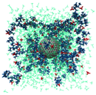
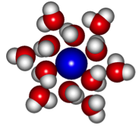
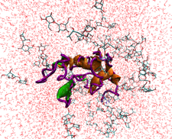
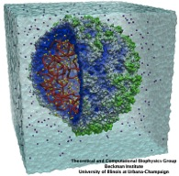
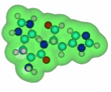

Molecular Sciences:
~30-50%
of the world
supercomputer time
(academia)
Experiments
We want to be here!!!
Conformational changes
Supramolecular complexes,
protein aggregates, nanodevices
Electron density
Solvation shell
QM
QM/MM
MM
Coarse-grain models
???
10⁻¹¹м
10⁻¹⁰м
10⁻⁹м
10⁻⁸м
10⁻⁷м
10⁻⁶м
10⁻⁵м
Computer Modeling
High-Performance Computing
Notes:
27

Slide 28


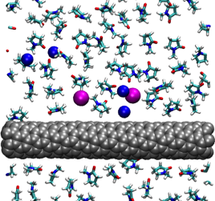

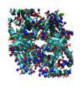
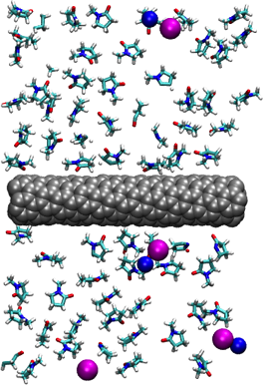

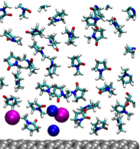
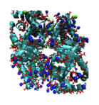
Molecular Modelling Tools
As a Computational Microscope
Understanding how things work on a detailed molecular level ranging from electronic structures to long-time phase behavior of molecules
If one understands how things work,
one can manipulate them!
!

Slide 29

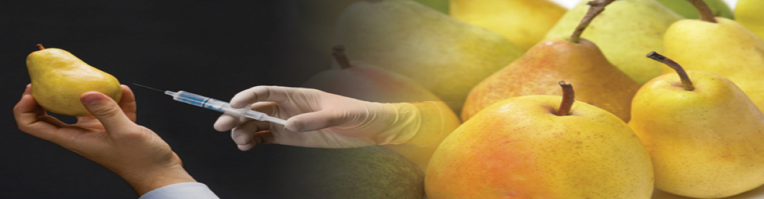
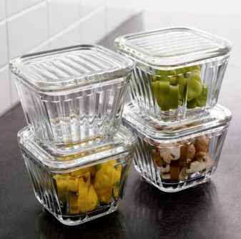
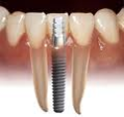
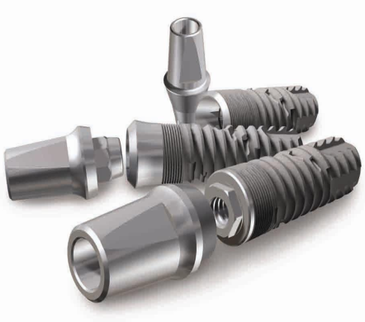
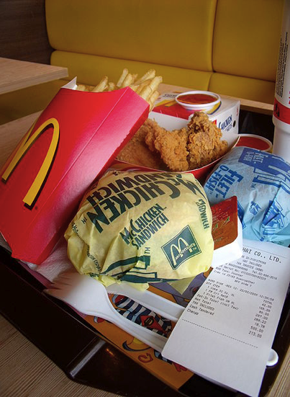
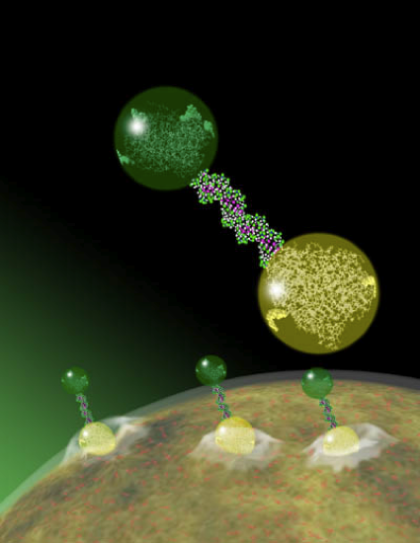
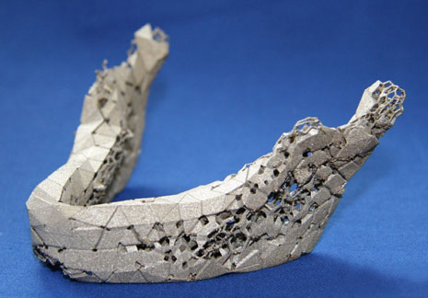
Protein Adsorption
Dr Paul Mulheran, University of Strathclyde, paul.mulheran@strath.ac.uk
Blah blah
Notes:
The interactions between proteins and solid surfaces are essential in biomaterials, medical implants, drug delivery systems, food storage, nanofood, separation …

Slide 30
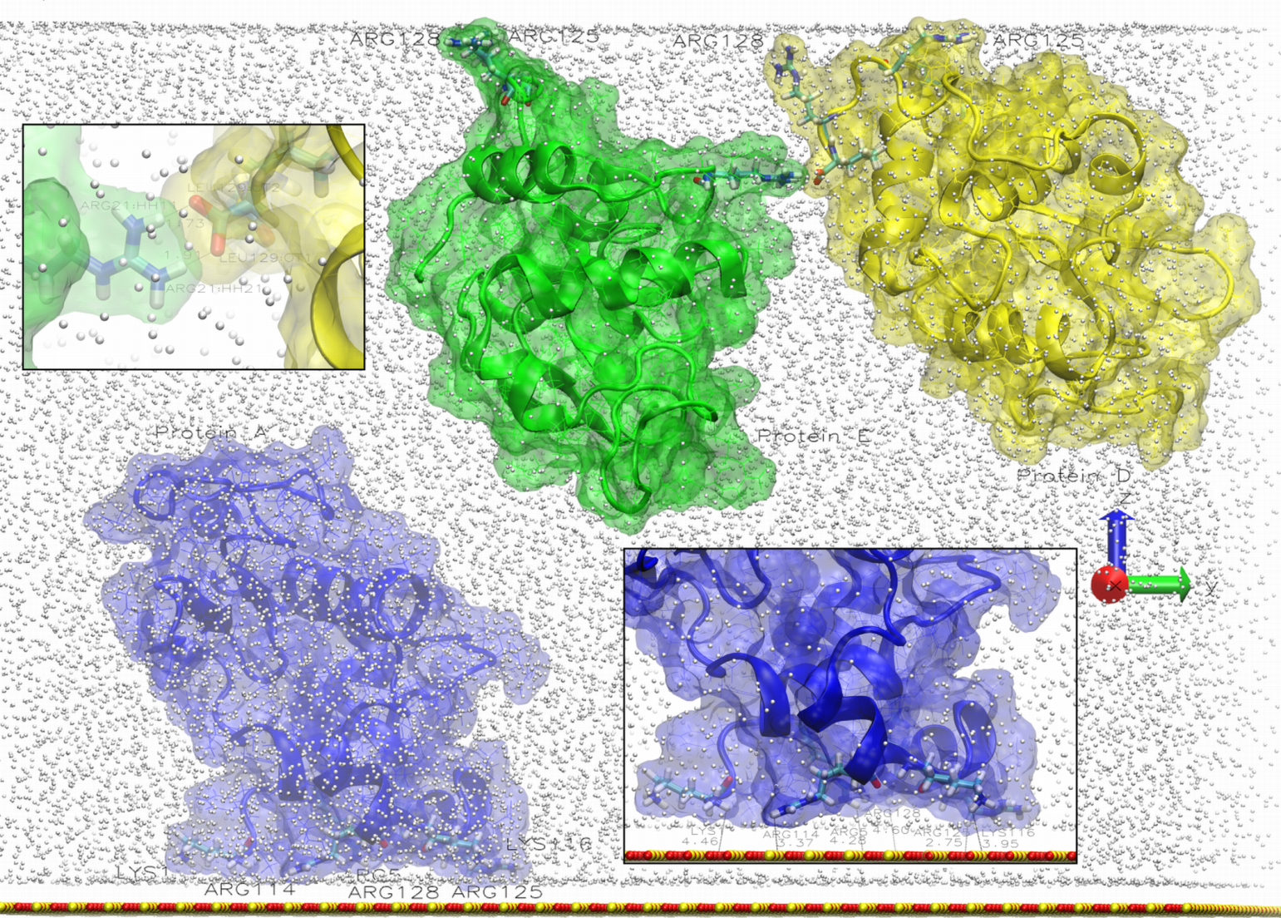
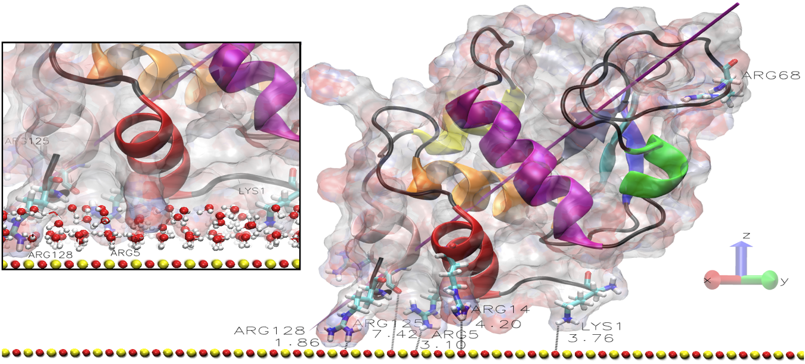
Adsorption
Thanks to the simulations we can see how the protein aggregates on atomistic level, describe the adsorption and the diffusion mechanism.
Notes:
bla

Slide 31
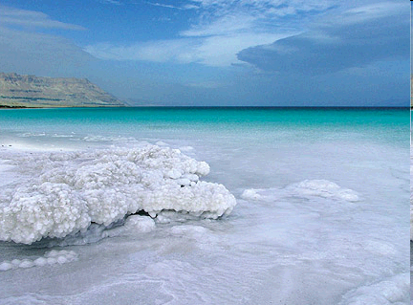
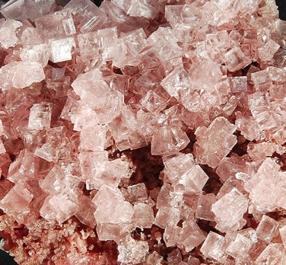
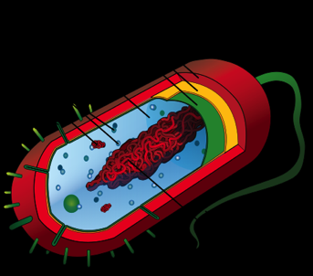
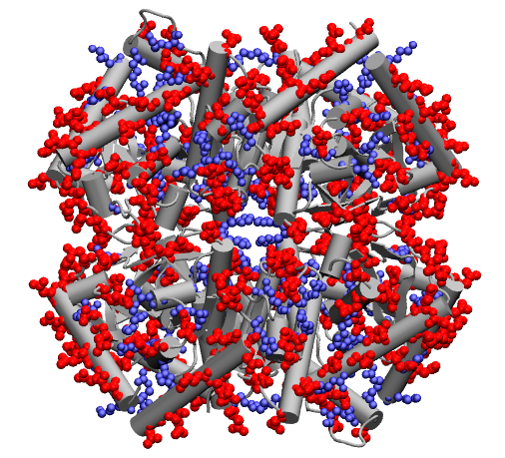
Halophilic proteins
Prof. Maxim Fedorov, University of Strathclyde, maxim.fedorov@strath.ac.uk
NaCl
(outside the cell)
KCl
(inside the cell)
Halophile = “salt loving”
Can grow in high salt concentrations
Notes:
Artificial life

Slide 32



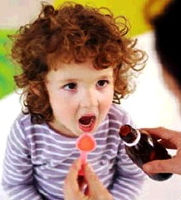
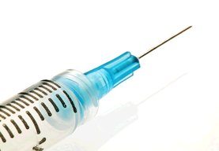



Drug Design
Prof. Maxim Fedorov, University of Strathclyde, maxim.fedorov@strath.ac.uk
People
do not like
injections
Drugs should be soluble in water to be successful on the market. A (sweet) tablet is the most preferable drug formulation

Slide 33
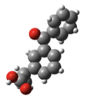
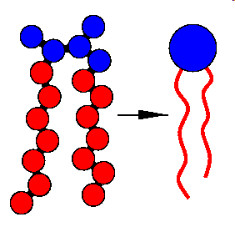
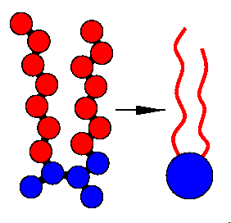
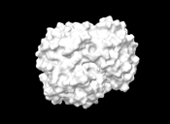
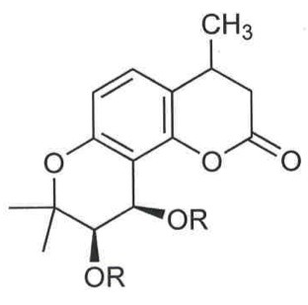
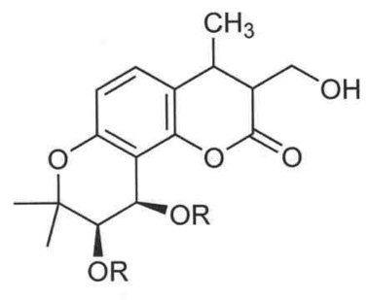
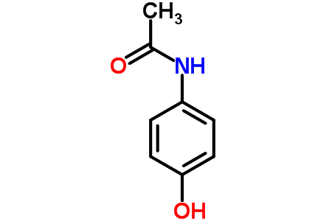
Drug Design
Prof. Maxim Fedorov, University of Strathclyde, maxim.fedorov@strath.ac.uk
drug
Aqueous
solubility
Intercellular water
Lipophilicity
Drugs should be soluble in lipids too. Structure modifications can improve physicochemical properties of drugs
cell membrane
(lipid)
target
intracellular water
Aqueous
solubility
Measuring solvation thermodynamic parameters for one compound requires up to: several months of work and £50-100 K per compound! With the computational approach it takes 10CPU hours per one compound.
H-bond donor
1
2
4
3
Anti-AIDS agents
Paracetamol
Phenacetin
Higher solubility in water
Higher solubility in lipids

Slide 34
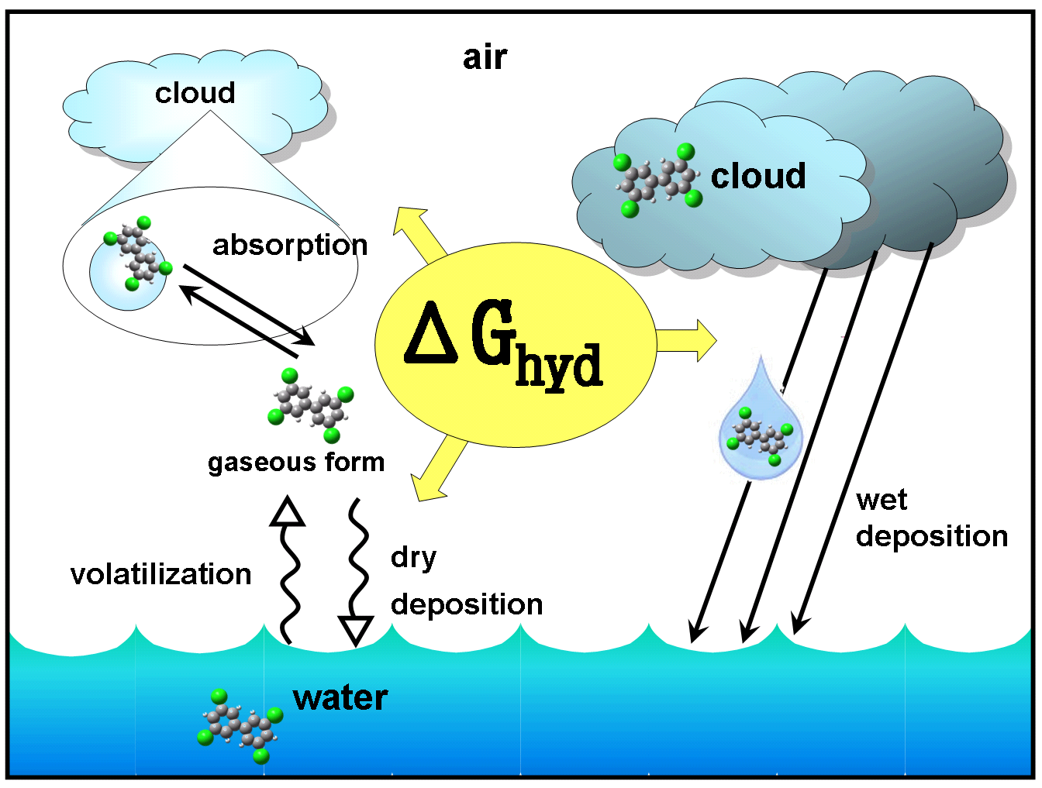
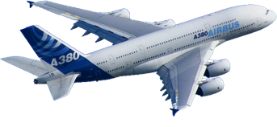
Pollutants
Prof. Maxim Fedorov, University of Strathclyde, maxim.fedorov@strath.ac.uk
Pollutants can travel thousands of miles with clouds. Pollutants in the air increase the greenhouse effect. Prediction of their fate is the most important problem of the environmental chemistry.
Hydration free energy is an essential parameter to predict the environmental pathways and toxicity of pollutants. And we can calculate this!

Slide 35
Examples
Computational Chemistry

Slide 36
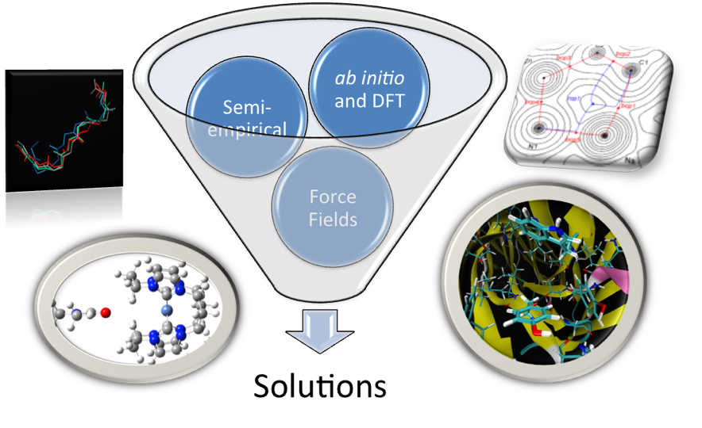
http://www.tuttlelab.com
Computational Chemistry
Dr Tell Tuttle, WestCHEM, University of Strathclyde, tell.tuttle@strath.ac.uk
The use of computational methods to solve chemical problems
Methods:
ab initio
DFT
Semi-empirical
Atomistic MM
Coarse grain
QM/MM

Slide 37
http://www.tuttlelab.com
Computational Chemistry
Dr Tell Tuttle, WestCHEM, University of Strathclyde, tell.tuttle@strath.ac.uk
Small Molecule Reactivity
  Ozonation Reactions
  Organic Super Electron Donors
  Synergic Synthesis
  Organometallic Catalysts
Molecular Properties
  IR Spectra
  Spin-Spin Coupling Constants
  NMR Chemical Shifts
  Mössbauer Parameters
  UV-Vis Spectra
Structure Activity Relationships in Biochemical Systems
  DNA Scission
  Ligand Binding
  Enzymatic Activity
  Peptide Self-Assembly

Slide 38

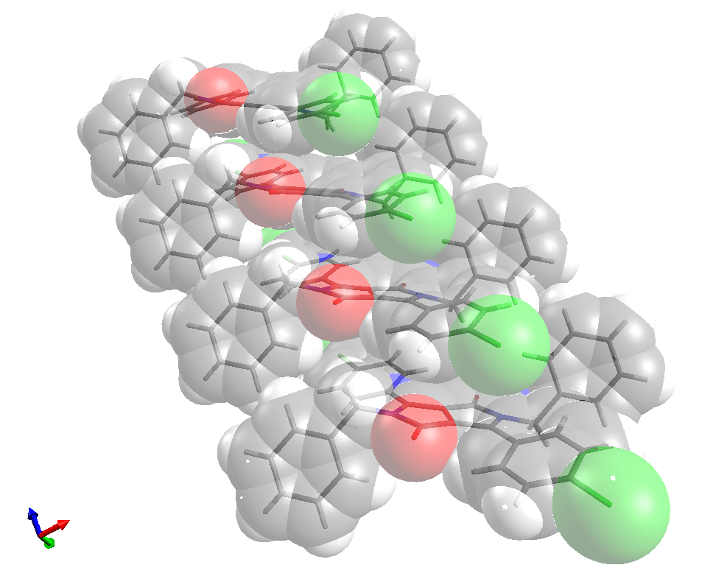
Electron transfer
in organic conducting materials
Dr Andrew McLean, University of the West of Scotland, Andrew.McLean@uws.ac.uk
Electrons “hop” between pigment molecules in stack (holes may “hop” in opposite direction.
Charge transfer rate constants can be estimated
Applications:
Organic photovoltacis
Organic field effect transistors
Organic LEDs

Slide 39
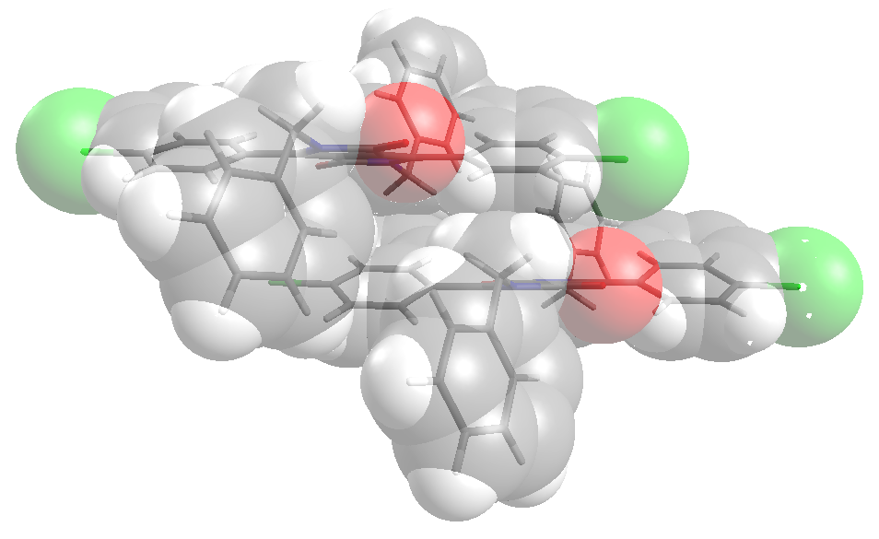
Electron transfer
in organic conducting materials
Dr Andrew McLean, University of the West of Scotland, Andrew.McLean@uws.ac.uk
Model of the temperature dependence of charge transfer process.
How thermally activated translational, rotational and torsional motion influences coupling between monomeric units within stacks?
Determine and model vibra-tional coupling responsible for determining re-organization energies.

Slide 40
Examples
Audio/Video
Signal Processing

Slide 41

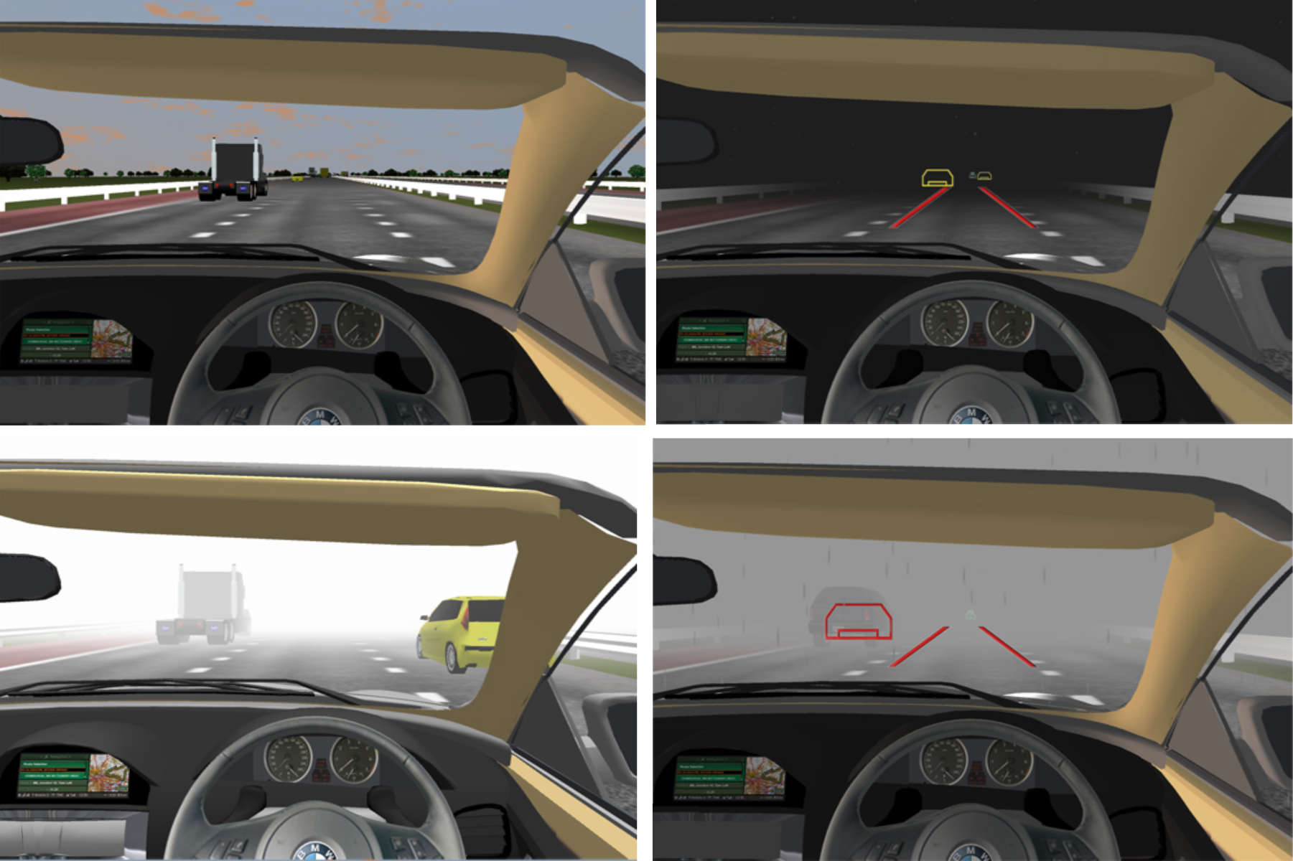
Vehicular AdHoc Network System
Dr Vassilis Charissis, Glasgow Caledonian University, vassilis.charissis@gcu.ac.uk
Self-Organized Time Division Multiple Access (STDMA) has been recently introduces as an alternative to 802.11 in vehicular networks.
Testing the system through prototype automotive Head-Up Display system.
Investigate two safety related scenarios of interest (potential collision situations) and report on which wireless access method allows for more timely propagation of the system information

Slide 42
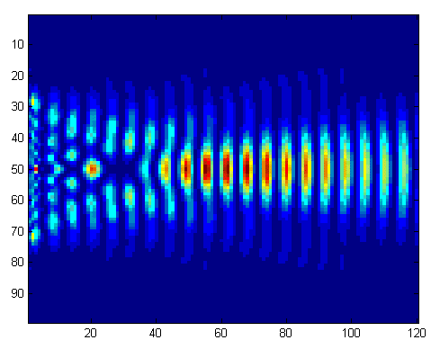
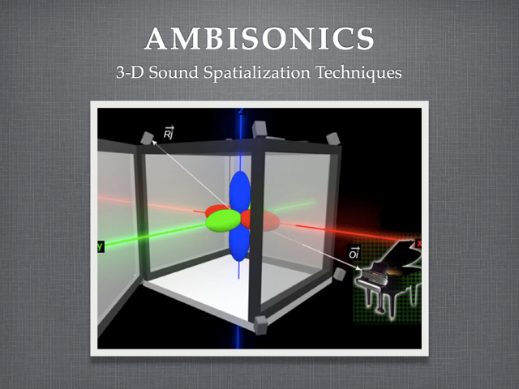
Audio Engineering
Projects
Dr J David Moore, Glasgow Caledonian University, j.d.moore@gcu.ac.uk
Advanced Acoustic Modelling
modelling of sound propagation in complex spaces
Spatial Audio:
-Design and optimisation of audio systems
- Use of brute force search

Slide 43
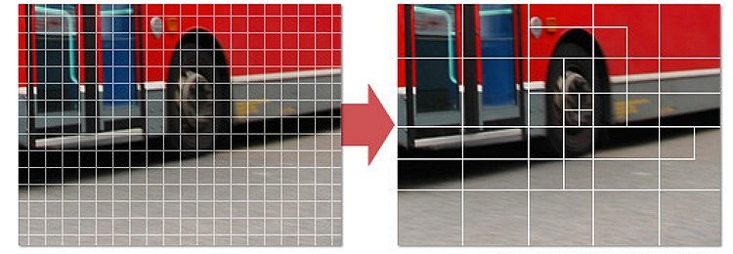
Video Networking Based
on High Efficiency Video Coding HEVC
Dr Qi Wang, University of the West of Scotland, qi.wang@uws.ac.uk
Current Standard HEVC
Next generation video coding\compression standard
Variable size coding units
50% improvement in compression over current standard
3 x computational complexity of existing standard

Slide 44
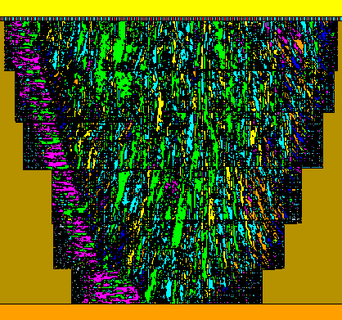

Ultrasonic engineering
Dr Tony Gachagan, University of Strathclyde, a.gachagan@strath.ac.uk
PZFlex software is used to simulate ultrasound propagation though a medium.
Results allow to test signals and image processing methods without a plethora of industrial samples (which are often difficult to obtain).
Simulation allows for repeatable experiments and controllable parameters, leading to more accurate results and accelerating research.
Grain structure of a weld
Notes:
Centre for Ultrasonic Engineering
fig is grain structure of a weld, modelled in PZFlex
shows the complexity of the materials that we're able to simulate
ultrasound transducer array is also present in the model (depicted by the red and blue stripes at the top of the image)

Slide 45
Examples
Biological Science

Slide 46


Frog Genetics
Prof. Julian Newman, Glasgow Caledonian University, jne@gcal.ac.uk
Dr. Quentin Mair, Glasgow Caledonian University, Q.Mair@gcal.ac.uk
Simulation of hemiclonal genetics of large frog populations
Agent-based problem requiring multiple search runs with different input data
Uses Java JADE
Notes:
Collaboration with University of Kharkov, Ukraine
Models complex frog populations and how genomes are passed on in different micro populations when taking into account different environmental factors
Already run on GCU cluster so don’t anticipate any difficulty in porting to Archie-West

Slide 47


Splicing of RNA
QM/MM Study
Dr Gregory Morozov, University of the West of Scotland, gregory.morozov@uws.ac.uk
RNA splicing: trimming and reassembling to create active molecule
Elucidation of the detailed quantitative mechanism of catalytic RNA splicing and self-splicing, prediction of factors that determine catalytic site selectivity, energy barriers and reaction routes. QM: calculation of small reactive site (ground energy, energy barriers, transition states). MM: the structure with charge distribution.

Slide 48


Neural Networks
Prof. Leslie Smith, University of Stirling, lss@cs.stir.ac.uk
Dr Bruce Graham, University of Stirling, bpg@cs.stir.ac.uk
Simulations of biologically plausible neural networks
Parallelised models using NEURON under Linux and Message Passing Interface (MPI)
Discrete time event simulation, with all communication between neurons being in the form of spike (action potential) times
Equal number of neurons on each computational node
Neurons model at fine scale with inner compartments and ionic gradients
Aims to simulate small secretions of the brain such as the hippocampus to better understand memory capacity and recall

Slide 49
Examples
Computational Optics

Slide 50

Nano Optics
Prof. Scott McMeekin, Glasgow Caledonian University, scott.mcmeekin@gcal.ac.uk
Nano Optics Research using FDTD Software
Notes:
Don
Intends to run simulations to compare with data from GCU experiments. Would help to develop / calibrate his model.

Slide 51

Complex Systems
Prof. Gian-Luca Oppo, University of Strathclyde, g.l.oppo@strath.ac.uk
A complex system is composed of interconnected parts that are capable of exhibiting global behavior not displayed by the lone components. Complex is the opposite of
independent, while complicated is the opposite of simple.
Nonlinear Sciences:
Solitons in semiconductor microcavities G.-L. Oppo et al., Nature Photonics 6, 204 (2012)

Slide 52




Complex Networks of Laser
5 mm x 5mm
2010-2011
50th anniversary of
Lasers and
Nonlinear Optics
Networks
Complex
Path Length
Connection with the Laser and Opto-electronic Industry
Prof. Gian-Luca Oppo, University of Strathclyde, g.l.oppo@strath.ac.uk

Slide 53
Future light sources – towards the atomic unit of time*
Light Sources
Dr Brian McNeil, University of Strathclyde, b.w.j.mcneil@strath.ac.uk
Spike width
FWHM = 4 optical cycles)
In the x-ray: enter the zepto-second regime – 10⁻²¹ s
This research needs HPC to model the Free Electron Laser that can output an ultra-short, high brightness x-ray strobe which would allow researchers to ‘see’ how all matter behaves at its own spatial and temporal scales.
*The time it takes an electron to travel approx. 1/3 of the way around an atom.

Slide 54

Optoelectronics Materials
Semiconductor spectroscopy
Dr Ben Hourahine, University of Strathclyde, benjamin.hourahine@strath.ac.uk
Modelling of electronic and optical properties of nanostructured materials – simulations of a wide range of deposition conditions for the growth of Nitride thin films. Global computational searches for stable dislocations in optoelectronics materials requires >100,000 simulations.
Different types of dislocation states corresponding to local minima in state energy.
Notes:
Semiconductor spectroscopy
simulating a wide range of deposition conditions for the growth of Nitride thin films. requires many simulations, each taking several days. global computational searches for stable dislocations in optoelectronics materials requires many simulations (> 100,000). Figure shows different types of dislocation states corresponding to local mimina in state energy. HPC used generally for large scale modelling of electronic and optical properties of nanostructured materials - computationally very intensive

Slide 55
Examples
Physical Science

Slide 56



Astronomy
Prof. Bonnie Steves, Glasgow Caledonian University, B.Steves@gul.ac.uk
Stability, chaotic behavior and periodic orbits
Integration of sets of differential equations for long duration
Exploration of evolution of orbits for multi-dimensional parameter spaces
Visualisation of orbits in 3D
B₂
B₄
C₁₂
C
C₃₄
B₁
B₃
The Caledonian Symmetric Four-Body System
Collisions & Close encounters
Planets of Binary stars
Three young stars fighting it out in Stellar Clusters
Notes:
Waiting for Bonnie to send us two slides on her work

Slide 57
Examples
Computational Fluid Dynamics

Slide 58




Pneumatic conveying
Prof. Don McGlinchey, Glasgow Caledonian University, D.McGlinchey@gcu.ac.uk
Multi-phase flow, computational fluid dynamics and discrete element models are applied to particulate solids handling pneumatic conveying.
Intention to run simulations at realistic scales and compare with experimental data (experiments performed at GCU)
ANSYS Fluent Euler-Euler model applied to pneumatic conveying
Notes:
Don
Intends to run simulations to compare with data from GCU experiments. Would help to develop / calibrate his model.

Slide 59



Oscillating wing
and vertical axis wind turbine
COSA
Dr M. Sergio Campobasso, University of Glasgow, Sergio.Campobasso@glasgow.ac.uk
Compressible Optimized Structured Algorithm (COSA): code suite of time- and frequency-domain turbulent Navier-Stokes (NS) solvers for external and internal flow unsteady aerodynamics.
Harmonic Balance NS technology substantially accelerates solution of unsteady periodic problems. Frequency-domain low-speed preconditioning is another unique feature of COSA (wind turbine applications).
Parallelization: MPI, OpenMP and mixed MPI/OpenMP.
Notes:
Don
Intends to run simulations to compare with data from GCU experiments. Would help to develop / calibrate his model.

Slide 60



Nanoliquid flows
Prof. Jason Reese, University of Strathclyde, jason.reese@strath.ac.uk
Particle simulations of flows: numerical experiments on fluids
Molecular Dynamics (MD)
one particle = one molecule
intermolecular potentials
Newtonian dynamics
deterministic collisions
Direct Simulation Monte Carlo (DSMC)
one particle = many millions of molecules
requires a mesh of cells
ballistic particle movement between cells
only particles in same cell can then collide
collision pairs and post-collision velocity directions selected randomly

Slide 61


Nanoliquid flows
Prof. Jason Reese, University of Strathclyde, jason.reese@strath.ac.uk
Droplets falling on the surface (60,000 molecules)
MD simulation domain: carbon nanotube (CNT) supported by graphene membranes between two water reservoirs at different pressures.
Notes:
Don
Intends to run simulations to compare with data from GCU experiments. Would help to develop / calibrate his model.

Slide 62



High speed flow
Prof. Jason Reese, University of Strathclyde, jason.reese@strath.ac.uk
Orion – part of NASA Constellation Programme for Moon and Mars exploration, cancelled March 2010. Orion technology is being developed as new crew rescue vehicle.
Freestream conditions:
Velocity 1404 m/s
Angle of attack 20⁰
Atmospheric altitude 100 km
CFD results DSMC results
Notes:
CFD – computational fluid dynamics
DSMC – Direct Simulation MC

Slide 63

Tidal Turbine Arrays
Mr Tom McCombes, University of Strathclyde, tom.mccombes@strath.ac.uk
Notes:
Tom McCombes, Mechanical & Aerospace Engineering
in-house solver for wake modelling of tidal turbine arrays
Compute unsteady device loads due to wake, turbulence and free-surface interactions
Improve confidence in device design, scaling experimental results and optimising array layouts
Supported by and informing EPSRC SUPERGEN Marine Phase 3 and FP7 MaRINET projects

Slide 64




Vertical Axis Wind Turbines
Dr Qing Xiao, University of Strathclyde, qing.xiao@strath.ac.uk
V rotor Turbine
H rotor Turbine
Full blade
CFD results show that under some optimal flap geometry and flow conditions, turbine power coefficient reaches 28.28% enhancement as compared to the conventional blade turbine.
Blade with slot
Oscillating flapper
Notes:
Qing Xiao, NAME
the power extraction enhancement of Vertical Axis Wind Turbine by using of a fixed and oscillating flap.
CFD results show that under some optimal flap geometry and flow conditions, turbine power coefficient (Cop) reaches 28.28% enhancement as compared to the conventional blade turbine.
Detailed analysis on the flow structure demonstrates that this is related to the effective flow separation suppression and vortex control by applying a fixed and oscillating flap

Slide 65
Examples
Analysis of Large Data Sets

Slide 66

Large Data Sets
Prof. Ken Turner, University of Stirling, kjt@cs.stir.ac.uk
Dr Simon Jones, University of Stirling, sbj@cs.stir.ac.uk
DAMES Project (Data Management through e-Social Science
Provides grid bases access to data storage and analysis for the Social Sciences. Data may be spread across a number of nodes but presented and analysed as a coherent whole
The DAMES portal uses a cluster to carry out potentially bulk, time consuming statistical data manipulation for end users
The front end of the DAMES portal is a data reception/curation/searching tool that allows jobs using R or Stata scripts to be run in the pool on data retrieving from DAMES distributed storage

Slide 67

Parameter Sweeping
Dr Savi Maharaj, University of Stirling, sma@cs.stir.ac.uk
Dr Adam Kleczkowski, University of Stirling, ak@cs.stir.ac.uk
Modeling how human behavioral changes affect the spread of disease epidemics
  Agent based stochastic model developed in NetLogo
  Deployed across cluster for parameter sweep and multiple replications
  Several million simulation runs per study

Slide 68

Parameter and Model
Optimisation
Dr David Cairns (dec@cs.stir.ac.uk), Dr Carron Shankland (ces@cs.stir.ac.uk)
Mr. Kevin Swingler (kms@cs.stir.ac.uk), University of Stirling
Evolve populations of parameter values for a given model using Evolutionary Computation techniques. (Evolving structural models of collagen to fit x-ray crystallography data – parameters control amino acid spacing)
Development and validation of new optimisation methods for optimal control problems
Cluster used to look for solutions and also validate results through reproducibility over multiple runs

Slide 69
Thank you for your attention
Contact us:
For general enquiries, please contact:
Dr Richard Martin, Tel: 0141 548 3265, Email: contact@archie-west.ac.uk
For commercial enquiries, please contact:
Dr Derek Bennet, Tel: 0141 548 2210, Email: derek.bennet@strath.ac.uk
For all other enquiries, please contact:
Prof. Maxim Fedorov, Tel: 0141 548 4012, Email: maxim.fedorov@strath.ac.uk
Dr Paul Mulheran, Tel: 0141 548 2393, Email: paul.mulhearn@strath.ac.uk

